Slide 1
UI/UX Case study-Mobile Banking App Redesign
Day 3 – Creating Wireframes and User Flow

Slide 2
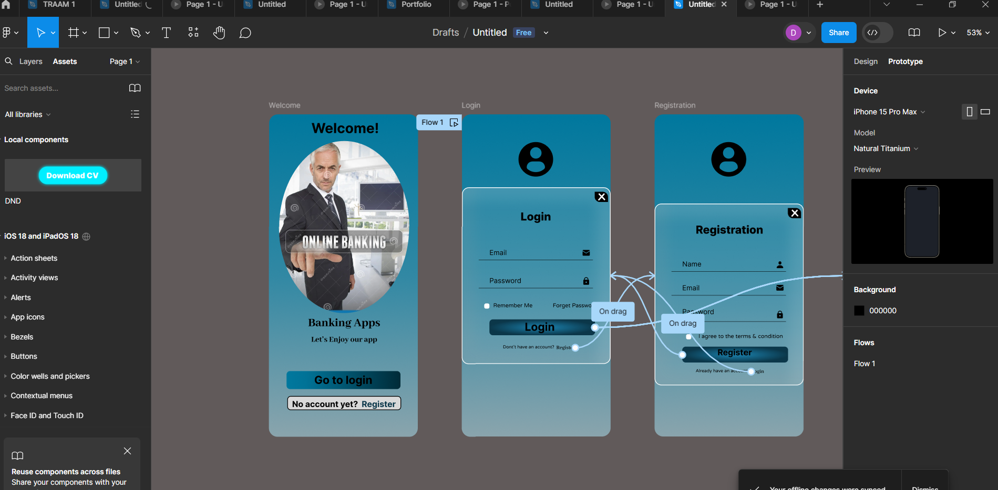
Design Core Screens Login and Registration Screens

Slide 3
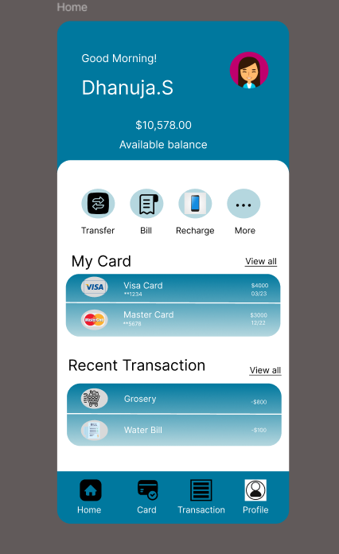
Home Dashboard

Slide 4
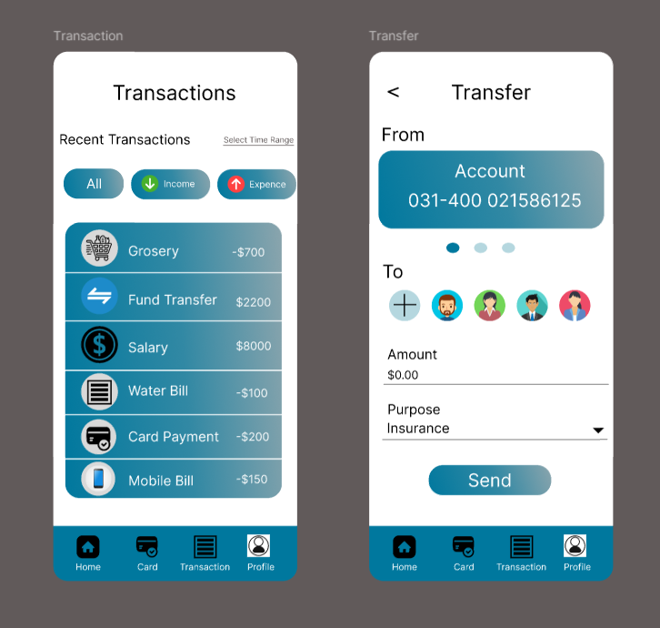
Transaction and Transfers

Slide 5
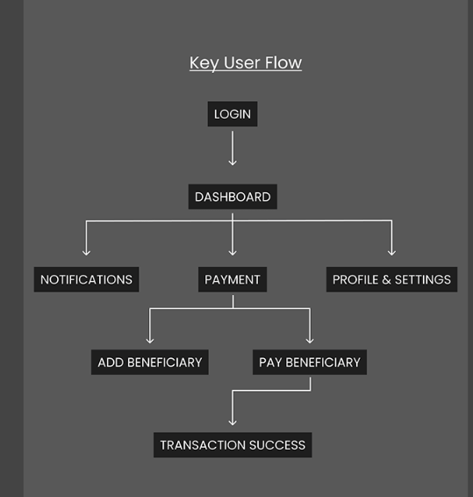
User Flow Diadram

Slide 6
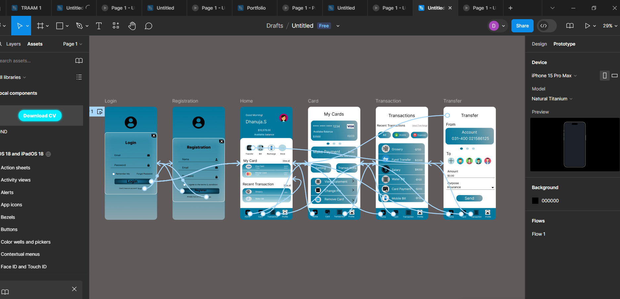
Clickable Prototypes

Slide 7
Conclusion
By the end of Day 3,I will have developed low fidelity wireframes for the core screens, create a detailed user flow diagram.
And also prepared a login and registration screens, Home dashboard and transaction & transfer Screens

